Slide 1
Guiding Principles for Open Doors New Futures

Slide 2
News flash! Church ain’t what it used to be.

Slide 3
1 John 3:2
”Beloved, we are God’s children now; what we will be has not yet been revealed. What we do know is this: when he is revealed, we will be like him, for we will see him as he is.”

Slide 4
The basic structure of Open Doors New Futures is based in theory from How to Lead When You Don’t Know Where You Are Going: Leading in a Liminal Season, by Susan Beaumont

Slide 5
Liminal, means on the doorstep, not here, not there, an in-between space or time.
Name your favorite, in-between stories in scripture:

Slide 6
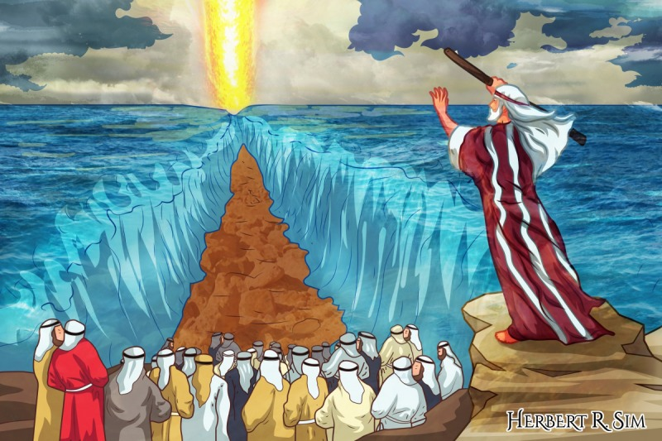

Slide 7
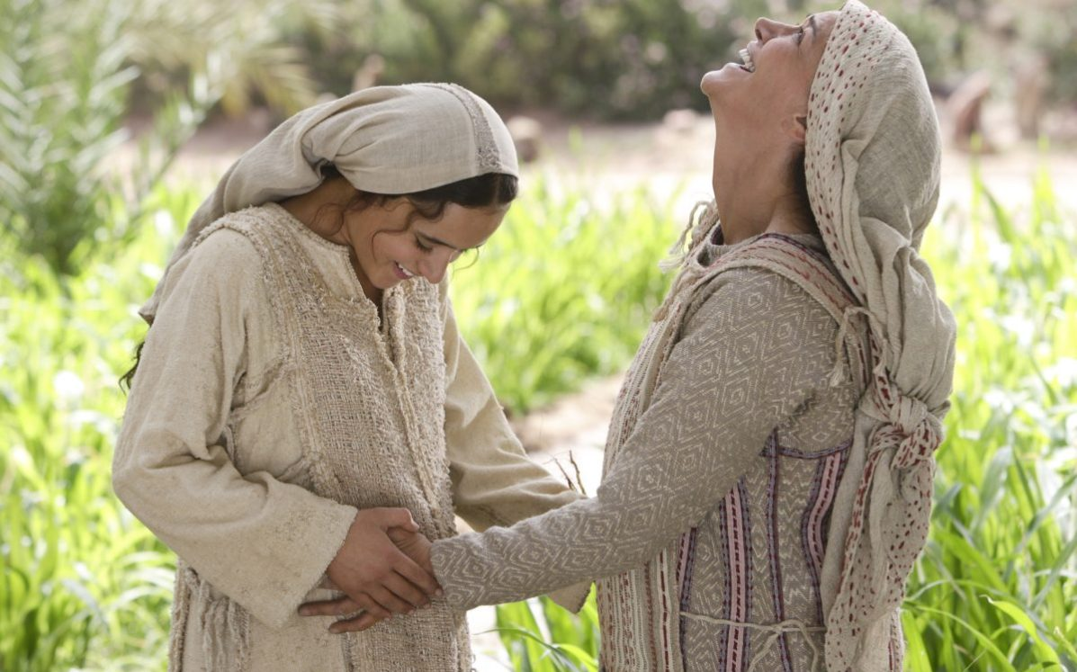

Slide 8
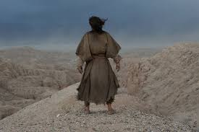

Slide 9
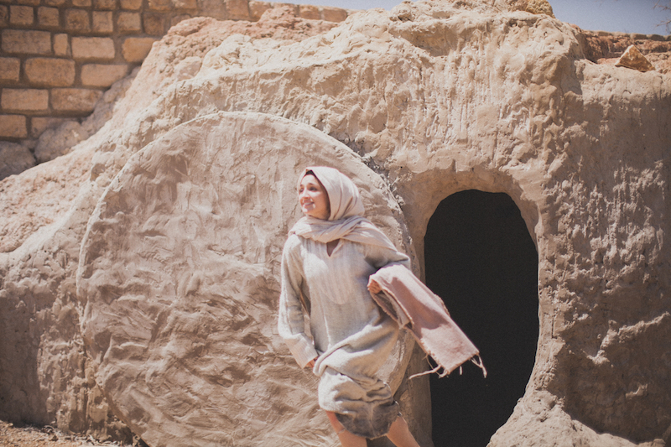

Slide 10
Onboarding and Vision is moving through the liminal doorway, from what was to what will be. What will be, will be rooted in God, and different from today.

Slide 11
Leading change requires Non-Anxious Presence for transformational, adaptive leadership.
From Knowing to unknowing.
From advocating to attending.
From striving to surrender.
Where is leading with non-anxious presence in Scripture?

Slide 12
Tending the Soul of an institution. basic practices.
Deepening communal discernment.
Shaping Institutional Memory.
Clarifying purpose.
Engaging emergence.

Slide 13
Discernment: Attentiveness to God, that, over time, develops into a sense of God’s intention.
Communal discernment, moving beyond personal to see what God is doing in the collective whole.
Attending to discernment requires practice in order to maintain discernment in times of anxiety and uncertainty. (P. 57 Grounded in God.)
Where does discernment appear in Scripture?

Slide 14
Mining Institutional Memory: Tell me our story…
In liminal seasons need clarity about the past.
Memory shaping helps institution hear prouds and sorries.
Locates where power for unknown future may come from.
Discerns patterns of dis-ease that undercut ability to attend to God, and see emergence: fixed on glory days of the past narrows capacity to see what is emerging now.
Where is shaping Insitutional Memory in Scripture?

Slide 15
Clarifying Purpose: Who does God call us to be, choosing what God desires.
Clarifies what is worth preserving, what needs to be released, and what needs to be adapted.
Who are we?
Who are we called to serve?
What do we stand for?
What is God calling us into next?
Where is clarifying purpose in Scripture?

Slide 16
Engaging emergence. Are we there yet?
Emergence resolves and leads/pulls us out of liminality, a direction emerges.
Reorients organization: coherence/shape emerges from chaos.
Leader can’t direct process outcomes.
Leader encourages and attends to what is emerging.
Leader and community nurtures sense of experiment, a climate of disruption and surprise, innovation, learning and risk taking that supports the new order/coherence as it emerges.
Where is emergence engaged in Scripture?

Slide 17
In Open Doors New Futures we encounter emergence, clarify and discern the signs and direction of the Holy Spirit:
Exploring the Mission Insight data
Neighborhood Prayer Walks
Neighborhood Conversations
Community Panel
Discovery Cafe

Slide 18
The Open Doors New Futures process will take you through the present and build many new relationships for the future, new friends and people to love that we can neither ask for or imagine…

Slide 19
In my Father’s house are many mansions. Who will you invite into your mission, your mansion?

Slide 20
Who will invite you into their mansion and their mission?
“You will receive power when the Holy Spirit has come upon you; and you will be my witnesses in Jerusalem, in all Judea and Samaria, and to the ends of the earth.“Acts 1: 8

